Slide 1
Binary Trees - I
Lecture # 14

Slide 2
Binary Tree ADT
So far the ADTs we studied are linear
Lists
Arrays
Stacks
Queues
Some applications require non-linear ADTs. Examples may include ADTs
To represent an organization
To represent class inheritance in OOP
To represent a complex algebraic expression
Or even to represent a collection of sorted numbers!

Slide 3
The Tree Structure
Consists of nodes and edges that organize data in a hierarchical fashion.
nodes – store the data elements.
edges – connect the nodes.
The organization of the nodes form relationships between the data elements.

Slide 4
Definition of a tree
A tree data structure is defined as follows.
A tree consists of a node called root
The root may have zero or more children
Each children itself is a tree
A recursive definition!

Slide 5
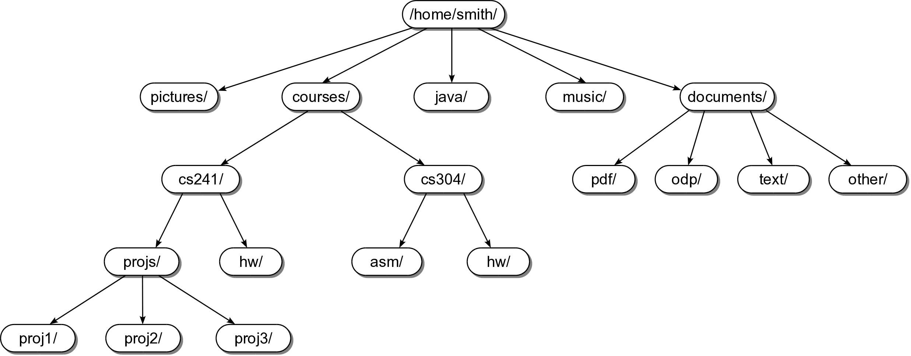
Tree Example #1
Linux file system is a tree!

Slide 6
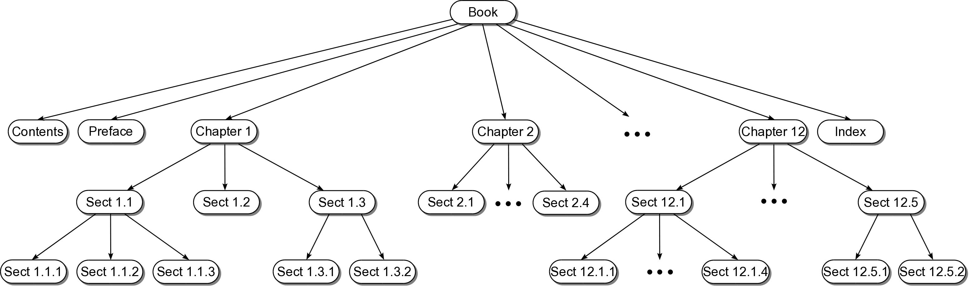
Tree Example #2
Chapters and sections in a book
can be organized as a tree!

Slide 7
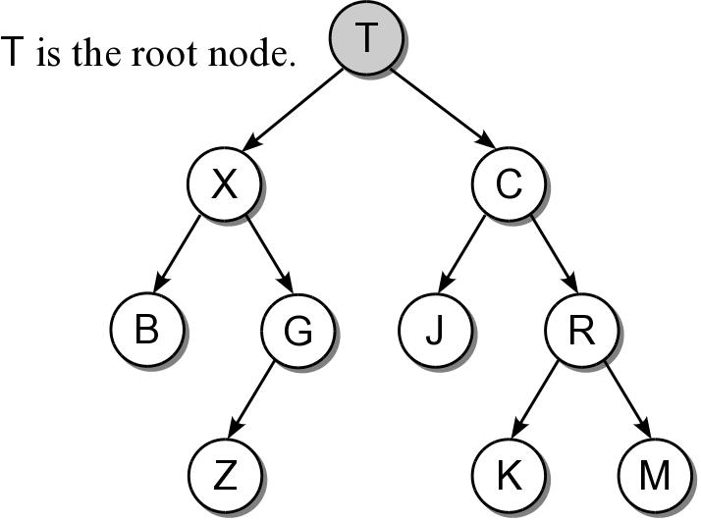
Root Node
Topmost node of the tree.
Provides the single access point into the tree.
Has no incoming edges.

Slide 8
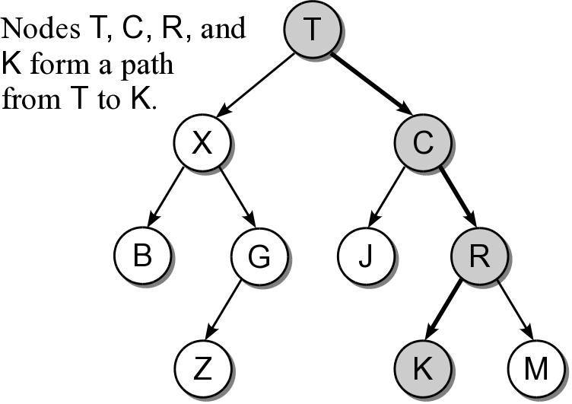
Tree Path
The nodes encountered when following the edges from the root node to the destination node.
Access to all other nodes must start with the root.

Slide 9
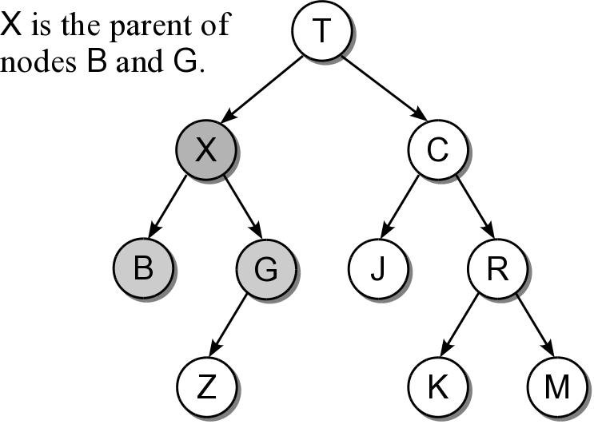
Parent Node
The node from which an incoming edge originates.
Every node, except the root, has a parent node.
A node can only have one parent.

Slide 10
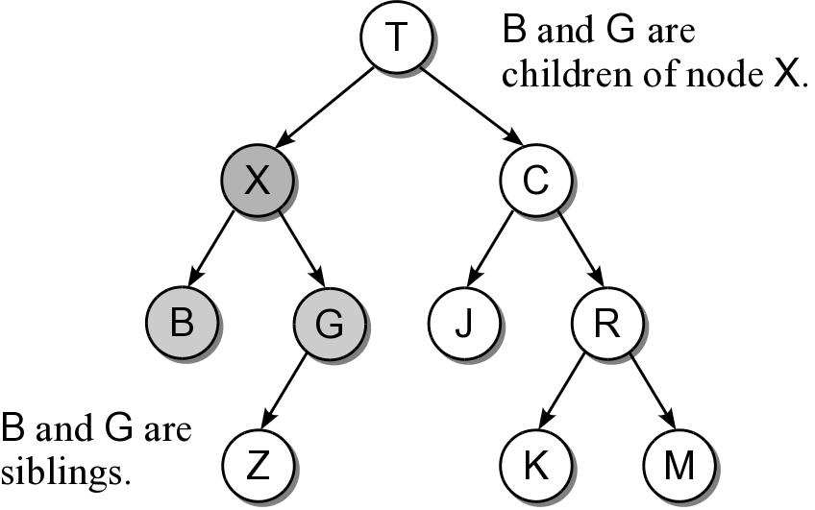
Child Node
The nodes to which outgoing edges are connected.
Each node can have one or more child nodes.
Results in a parent-child relationship.
sibling nodes – all nodes that have the same parent.

Slide 11
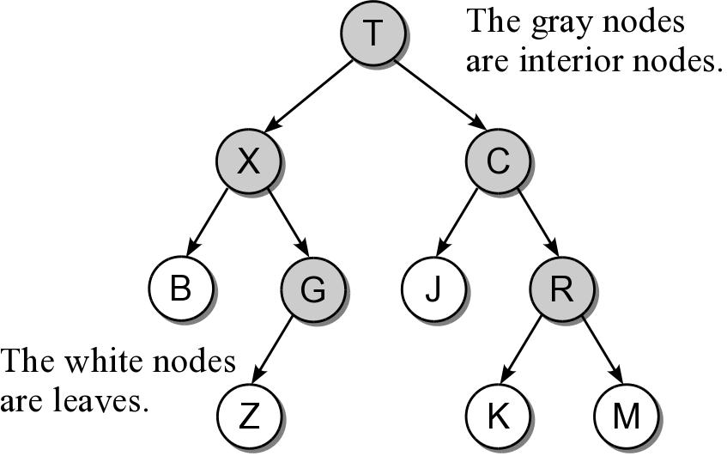
Types of Nodes
Nodes can be classified as either:
interior node – a node that has at least one child.
leaf node – a node that has no children.

Slide 12
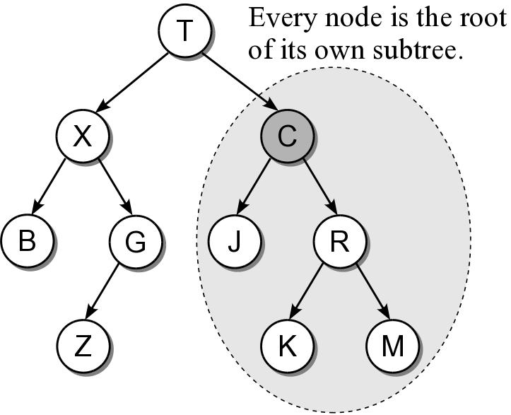
Subtree
A tree is by definition a recursive structure.
Every node can be the root of its own subtree.
A subtree consists of a subset of nodes and edges of the larger tree.

Slide 13
Relatives
descendants
All nodes of a subtree are the descendants of the subtree's root.
Every node in the tree is a descendant of the root.
ancestors
The ancestors of a node include all of the nodes along the node's path, excluding the node itself.
The root is the ancestor of all the other nodes.

Slide 14
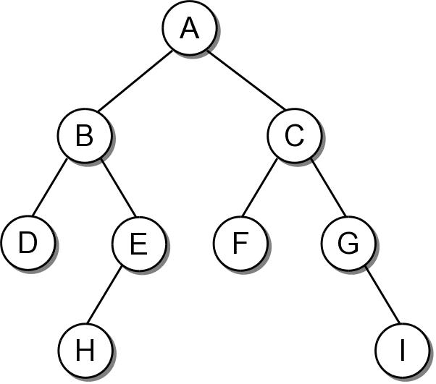
The Binary Tree
A tree in which each node can have at most two children. The nodes are commonly labeled:
left child
right child

Slide 15
Binary Tree Properties
There are several properties associated with binary trees that depend on the node organization.
depth – the distance of a node from the root.
level – all nodes at a given depth share a level.
height – number of levels in the tree.
width – number of nodes on the level containing the most nodes.
size – number of nodes in the tree.

Slide 16
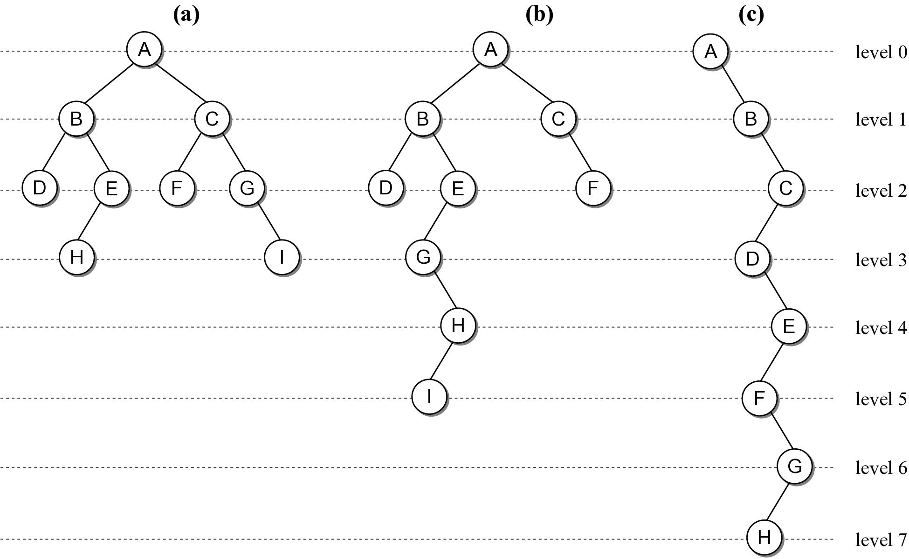
Binary Tree Properties

Slide 17

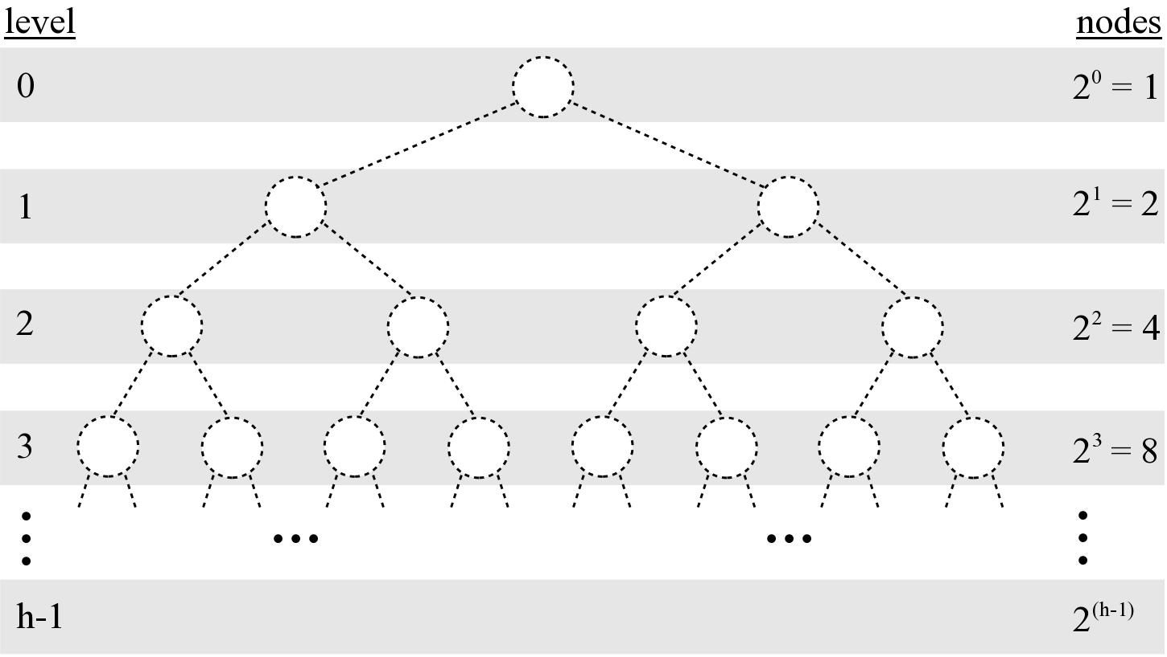
Binary Tree Properties
Given a tree of size n:
max height = n
min height =

Slide 18
Binary Tree Structure
Height of a tree will be important in analyzing the efficiency of binary tree algorithms.
Structural properties can play a role in the efficiency of an algorithm.

Slide 19
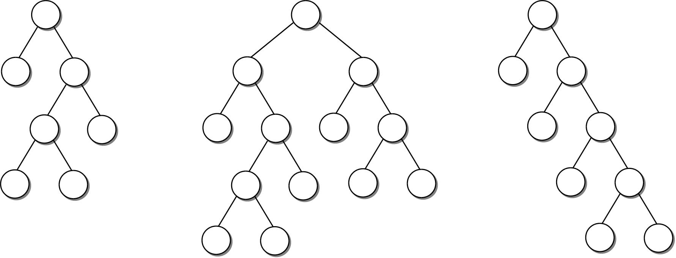
Full Binary Tree
A binary tree in which each interior node contains two children.

Slide 20
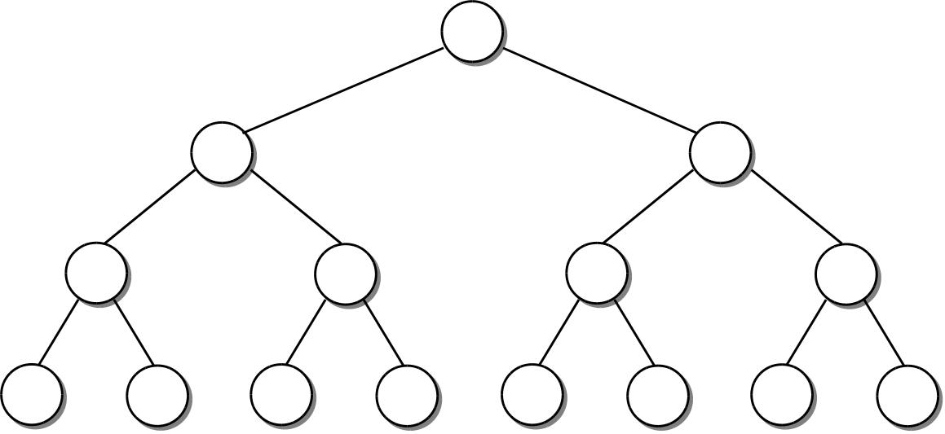
Perfect Binary Tree
A full binary tree in which all leaf nodes are at the same level.

Slide 21
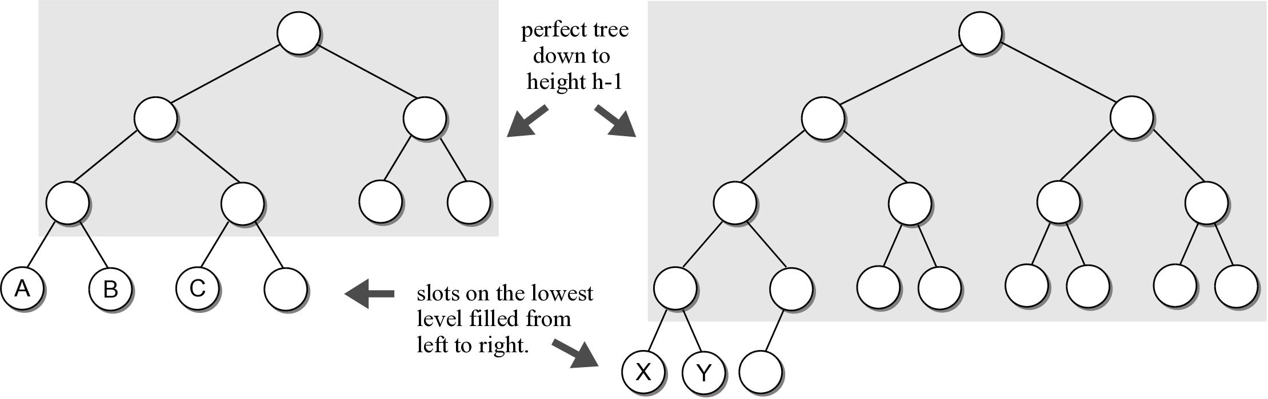
Complete Binary Tree
A binary tree of height h, is a perfect binary tree down to height h – 1 and the nodes at the lowest level are filled from left to right (no gaps).

Slide 22
Binary Tree Implementation
Many different implementations. We’ll discuss two.
Linked node based
Array based

Slide 23
Linked node based
# The storage class for creating binary tree nodes.
class BinTreeNode :
def __init__( self, data ):
self.data = data
self.left = None
self.right = None
def set_left(self, leftnode):
”””Set the incoming node as the left child”””
self.left = leftnode
”””similar functions follow”””
def set_right(self, rightnode):
def set_data(self, new_data):
def get_data(self):
def get_left(self):
def get_right(self):
bintreenode.py

Slide 24
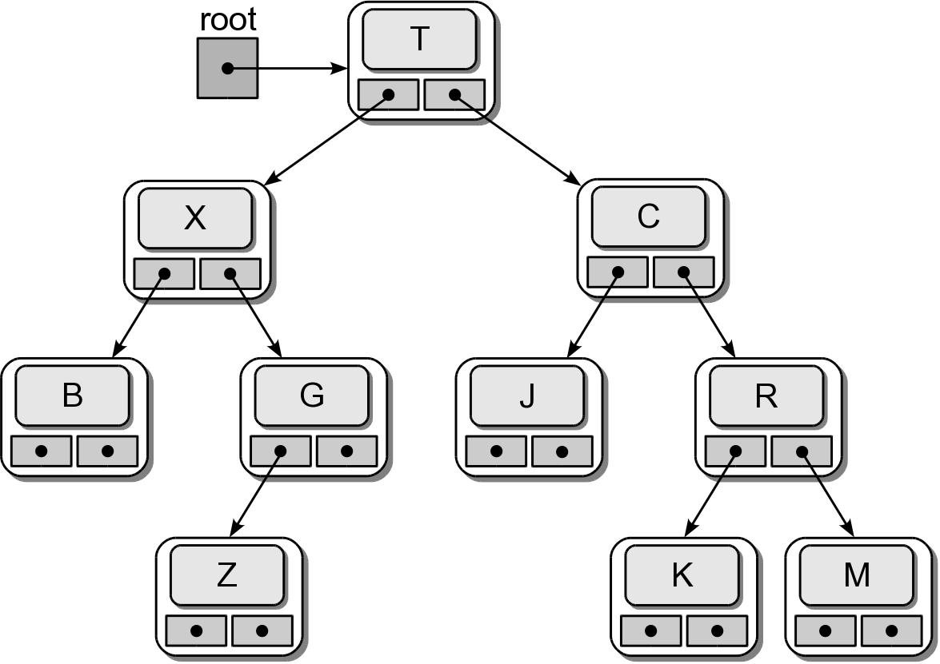
Physical Implementation
testbintree.py

Slide 25
Tree Traversals
Iterates through the nodes of a tree, one node at a time in order to visit every node.
With a linear structure this was simple.
How is this done with a hierarchical structure?
Must begin at the root node.
Every node must be visited.
Results in a recursive solution.

Slide 26
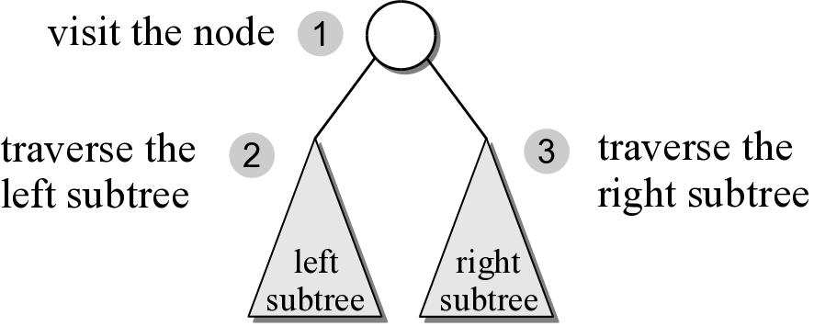
Preorder Traversal
After visiting the root,
traverse the nodes in the left subtree
then traverse the nodes in the right subtree.

Slide 27
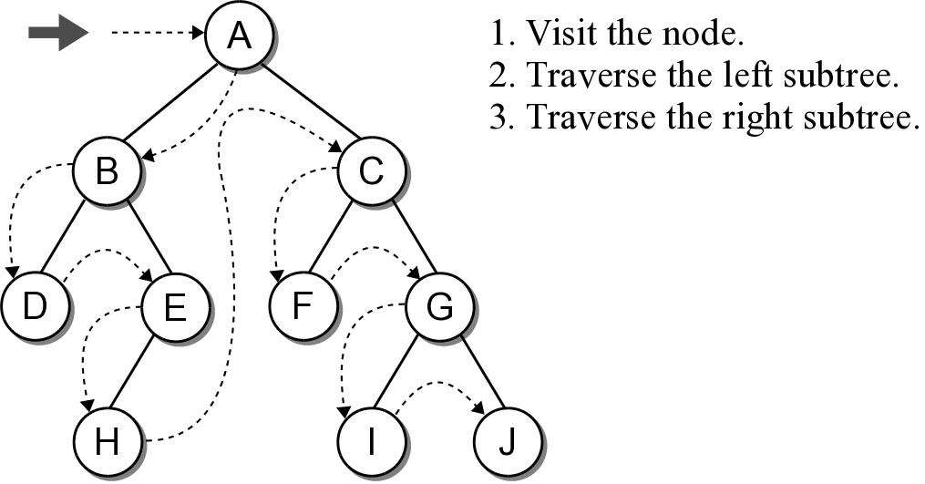
Preorder Traversal
Print A A.Left Print B B.Left Print D D.Left → none B.Right Print E E.Left Print H H.Left → None H.Right → None E.Right → None | A.Right Print C C.Left Print F F.Left → None F.Right → None C.Right Print G G.Left Print I I.Left → None I.Right → None G. Right Print J J.Left → None J.Right → None
def preorderTrav( subtree ):
if subtree is not None :
print( subtree.data )
preorderTrav( subtree.left )
preorderTrav( subtree.right )

Slide 28
Preorder Traversal
The implementation is rather simple.
Given a binary tree of size n, a complete traversal requires O(n) to visit every node.
def preorderTrav( subtree ):
if subtree is not None :
print( subtree.data )
preorderTrav( subtree.left )
preorderTrav( subtree.right )

Slide 29
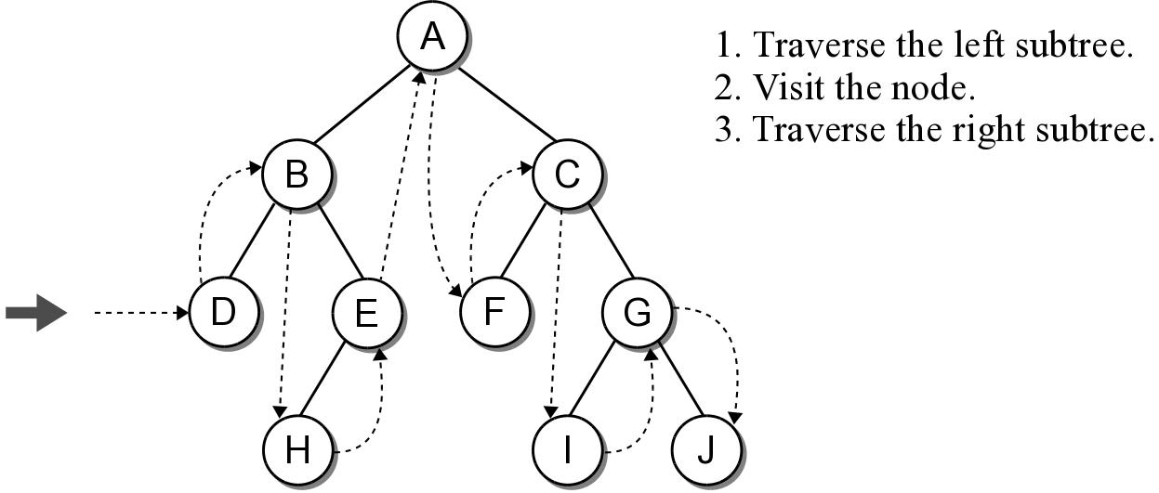
Inorder Traversal
A.Left B.Left D.Left → None Print D D.Right → None Print B B.Right E.Left H.Left → None Print H H.Right → None Print E E.Right → None Print A A.Right C.Left F.Left → None Print F | F.Right→ None Print C C.Right G.Left I.Left → None Print I I.Right → None Print G G.Right J.Left → None Print J J.Right –None
Similar to the preorder traversal, but we traverse the left subtree before visiting the node.
def inorderTrav( subtree ):
if subtree is not None :
inorderTrav( subtree.left )
print( subtree.data )
inorderTrav( subtree.right )

Slide 30
Inorder Traversal
The implementation swaps the order of the visit operation and the recursive calls.
def inorderTrav( subtree ):
if subtree is not None :
inorderTrav( subtree.left )
print( subtree.data )
inorderTrav( subtree.right )

Slide 31
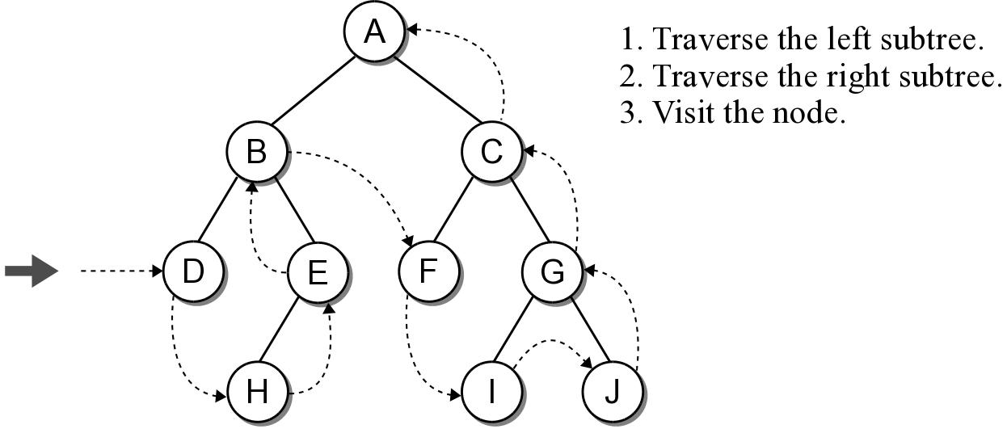
Postorder Traversal
Is the opposite of the preorder traversal.
Traverse both the left and right subtrees before visiting the node.
def postorderTrav( subtree ):
if subtree is not None :
postorderTrav( subtree.left )
postorderTrav( subtree.right )
print( subtree.data )
Do yourself

Slide 32
Postorder Traversal
The implementation swaps the order of the visit operation and the recursive calls.
def postorderTrav( subtree ):
if subtree is not None :
postorderTrav( subtree.left )
postorderTrav( subtree.right )
print( subtree.data )

Slide 33
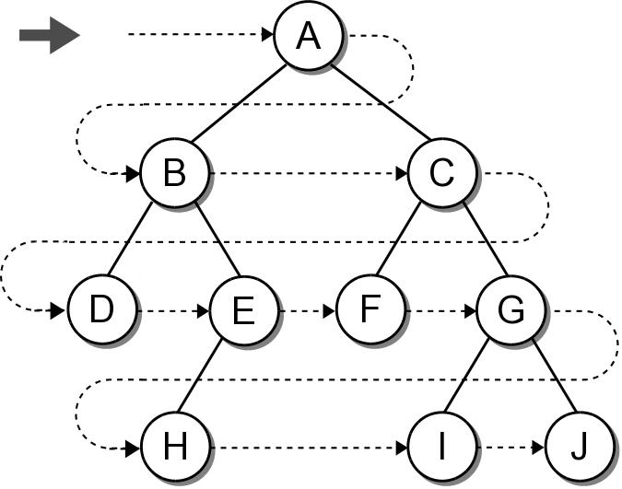
Breadth-First (level order) Traversal
The nodes are visited by level, from left to right.
The previous traversals are all depth-first traversals.

Slide 34
Breadth-First Traversal
Recursion can not be used with this traversal.
We can use a queue and an iterative loop.
def breadthFirstTrav( bintree ):
Queue q
q.enqueue( bintree )
while not q.isEmpty() :
# Remove the next node from the queue and visit it.
node = q.dequeue()
print( node.data )
# Add the two children to the queue.
if node.left is not None :
q.enqueue( node.left )
if node.right is not None :
q.enqueue( node.right )
Enqueue | A | C,B | E,D,C | G,F,E,D | H,G,F | J,I,H
Dequeue | A | B | C | D,E | F,G | H,I,J

Slide 35
Array based binary trees
It is very nature to implement binary trees using linked nodes.
For binary tree that has “many” nodes, it may be more effective and efficient to implement it using an array!

